Slide 1

Developing
resilience
In
Speaker: Narescha Naidoo
Student Educational Psychologist
University of Pretoria
Miss Naidoo
Teacher’s assistant – Discovery Primary Full Service School

Slide 2

What is resilience?
“Resilience is the human capacity to face, overcome and be strengthened by or even transformed
by the adversities of life.”
Everyone faces adversity, no one is exempt.
Globally, many children ‘face adversity and the number of adversities
they face appears to be increasing’ (Goldstein & Brooks, 2013, p. 3).
The crises children face both
within their families and in their communities can overwhelm them.
Notes:
The
nature and extent of these adversities are reported in annually updated
reports (see, for example, UNICEF's State of theWorld's Children reports,
http://www.unicef.org/publications/index.html).Among others, poverty,
chronic parental discord, violence, experiences of trauma, disability, and
ill health place children at risk of negative developmental outcomes. In
2010, for example, 60% of all South African children lived below the
poverty line (i.e., on less than $50/month), 3.8 million children were
orphaned (80% of which were of school-going age), and 0.5% (around
90 000 children) were living in child-headed households (Hall,
Woolard, Lake, & Smith, 2012). Growing up with such challenges
threatens children's positive development

Slide 3
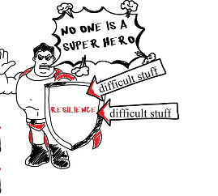
How do we teach children to enjoy learning and really love school?
How do we engage children in the learning process?
How do we as parents and educators instil good self-esteem in our young people?
How do we raise children who not only survive but thrive?
We need to teach our infants, toddlers, pre-schoolers, primary school learners and adolescents to be resilient and have a growth mind-set.

Slide 4
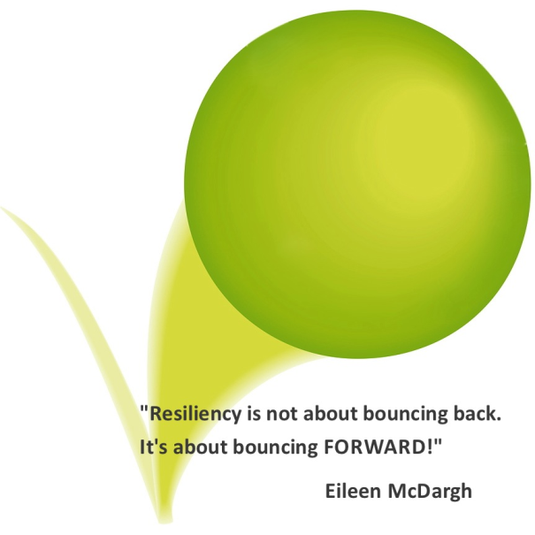
We are born with the capacity for resilience.
But resilience is not something we have or don’t have.
We work on it throughout our lives.
And we need to start as early as possible.
Parents are the most important people to help build
their children’s resilience.
Children learn a lot by watching their parents.
When parents cope well with everyday stress, they
are showing their children how to do the same.
Resilience is the ability to steer through
serious life challenges and find ways to
bounce forward and to thrive.

Slide 5
What Do We Need to Know to Build Resilience?
We need both inner strengths and outside supports to build our resilience.
Inner strengths may include:
positive outlook/ learned optimism
self-control
• thinking skills
• confidence
• responsibility and
participation

Slide 6
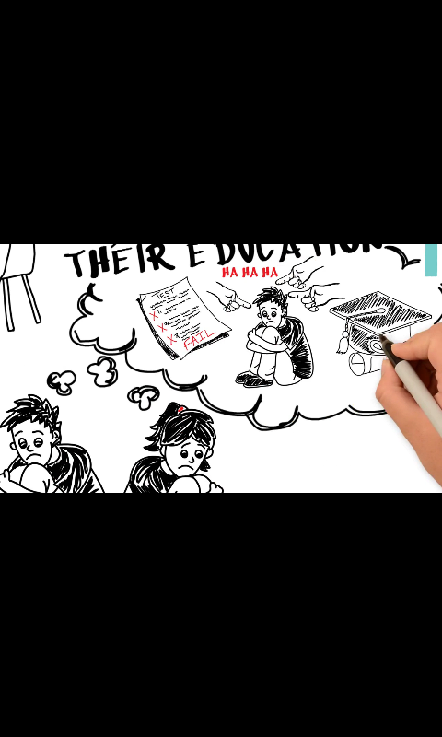
Poverty, neglect, trauma, anxiety, emotional and physical abuse may produce disempowered angry children
Underneath the anger of young people lies hurt, helplessness and deep pain.
The problems of many of these young people can be lessened through the efforts of many kind and caring teachers and parents who teach a different model.
“At the core of every problem is an
issue of:
I don't love enough.
I am not lovable.
I don't deserve love.
I am unworthy.
People cannot be trusted.”
“At the core of every solution:
I am worthy
I deserve love.
I can find the peaceful solution to this.
I love myself for I am lovable. “

Slide 7
Positive thinking
Learned
optimism
Self-confidence

Slide 8
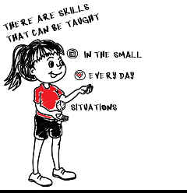
Feeling stressed and becoming overwhelmed when we believe that we don’t have the necessary skills and resources to deal with unhappy events is common.
Feelings of helplessness and dread build up when we are faced with a situation that we don’t think we can handle.
CHILDREN FEEL THIS WAY TOO!
Immunizing children against stress and depression by teaching learning to deal with failure in small bits and overcoming it through effort. Children should be taught how to deal with failure as it is part of learning.
Children develop a solid self-esteem through effort and experiencing mastery, persistence, overcoming frustration and boredom, and meeting challenges.
These are the skills recognised and rewarded by the real world.

Slide 9
Don’t worry. . .
Correct your worry thought by calling it out, giving it a name and challenge it by telling it to go away.
Turn it around and think of the best thing that could happen.
Stop worrying about what could go wrong and think of one thing that could go right.
Now think of another thing. And another thing. Get excited about what might happen for the best.
Helper Words:
1.I use my worry to get a plan to deal with my problem and then let it go.
2. If plan A doesn’t work, there are 25 more letters in the alphabet.
3. I stop thinking about what could go wrong and think of what could go right.
4. Is my worry the kind I need to let go of or get a plan for?

Slide 11
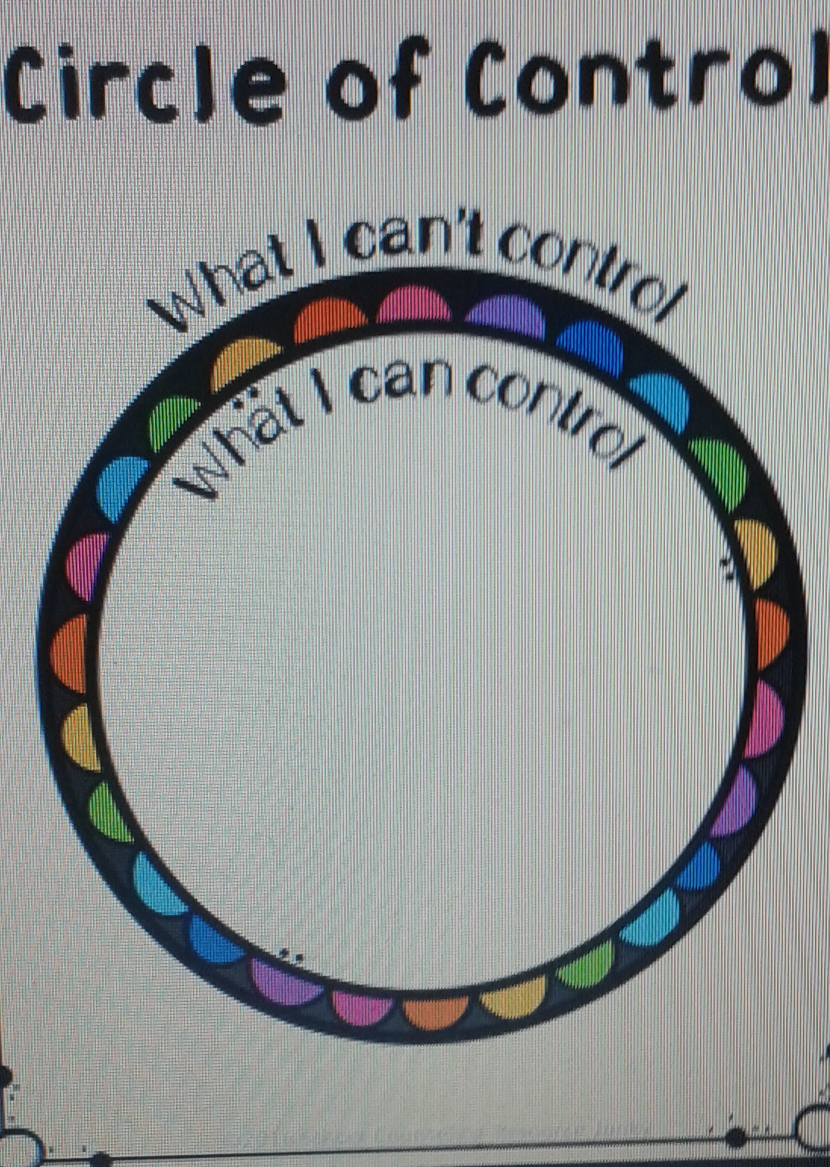

Slide 12
Tips for helping children 3 years and older develop thinking skills
• Help your children talk about their thoughts. Often when we ask children to tell us what they are
thinking, they shrug their shoulders and say, “I don’t know.” However, questions like, “What are you
saying to yourself inside your head?” or “What is your head telling you?” often helps children to express
thoughts that cause their feelings and behaviours.
For example, a child who refuses to get dressed in the morning may be able to tell us what is actually
causing this behaviour. “I hate daycare! Everyone takes my toys. No one wants to play with me. I hate
daycare!!!”
• Show empathy for your
children’s thoughts and
feelings. “I understand. you’re feeling sad and mad about what happens in daycare.” Then, think
together about ways to
make the situation better.
“Let’s talk with your teacher
about helping you enjoy
your time at daycare.
Yesterday, when I picked you
up, you were eating snack
and laughing with Sanjay.
Maybe you and Sanjay
could play together today.”
1 2 Building Resilience in Young Children
• Gently challenge your children’s negative thinking.
• Read or tell children stories about how others overcome obstacles, get along with others or turn a
The research consistently shows that we need to teach children how to think and that their potential in an area of endeavor is not limited.
Teach them that adversity is a part of life that they can deal with it as part of a life-learning process.
Teach children how to think about their emotions, abilities, talents, needs, beliefs and goals and how their brain circuits can be changed by positive thinking.
Thinking skills
1. Help your children talk about their thoughts.
2. Show empathy for your children’s thoughts and feelings.
3. Gently challenge your children’s negative thinking.
– “Always” thinking
– “Everything” thinking
4. Encourage children to imagine another way to do something – like a different way to join others at the playground, play with toys or tidy up. This helps them learn there is usually more than one way to do things.

Slide 13
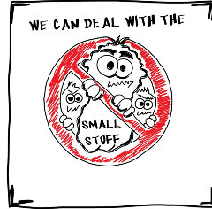
Self control: WORK IT OUT OR ACT IT OUT
Unhappy and angry feelings are normal when something bad happens.
Too often we learn to stuff them down because they are uncomfortable.
But then feelings get bogged down and pile up and bust out when we don’t want them to.
It is normal to have strong feelings when you have been hurt or when something went wrong.
It’s what you do with your feelings that count.
They are just feelings to be felt and then do something with. When you are angry would it be better to work angry feelings out or act them out?

Slide 15
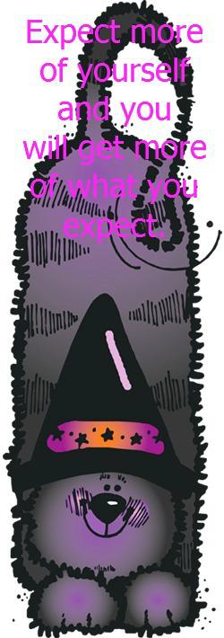
Teach children to:
TAKE RESPONSIBILITY, TRY AGAIN AND
FEEL GOOD ABOUT THEMSELVES!

Slide 16
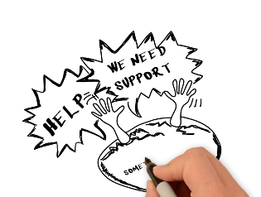
Remember. . . You are not alone!
OuTSide SuppORTS
Caring Relationships : Helps us feel loved, understood and accepted, and protected from harm. Feeling wanted and loved helps us get through the hard times in life.
Positive Role Models Helps us see how others persevere, and stay calm and flexible, in dealing with life’s challenges. Children learn these life skills by watching and copying adults.
Community Resources Helps us when we need extra assistance in dealing with hard times.
Asking for help is a sign of being resilient– everyone needs help sometimes.

Slide 17
When Parents: | Kids:
SHOW AFFECTION & ATTENTION | Feel loved & connected • Have a sense of worth
LISTEN/UNDERSTAND | Feel understood & accepted • Understand others
STAY CALM | Calm themselves and Handle stressful situations
SHOW PATIENCE | Wait • Develop patience
STOP & RE-THINK | Stop and think • Be creative problem-solvers
TAKE RESPONSIBILITY & BE INVOLVED | Be responsible & involved • Feel they belong
VIEW MISTAKES as OK | See mistakes as part of learning • Try new things

Slide 18
Sometimes bad stuff happens.
We all have tough times in life.
Tough times require your finding your courage and getting tougher.
Being resilient is getting back up
after you fall.
Hang calm; take a deep breath and yell,
“I use my Helper Words.
“I will get through this. I will survive!”

Slide 19

“When will we also teach them what they are?
We should say to each of them:
Do you know what you are?
You are a marvel. You are unique.
In all the years that have passed,
there has never been another child like you.
Your legs, your arms, your clever fingers,
the way you move.
You may become a Shakespeare,
a Michelangelo, a Beethoven.
You have the capacity for anything.
Yes, you are a marvel.
And when you grow up, can you then harm
another who is, like you, a marvel?
You must work; we must all work,
to make the world worthy of its children.”
Pablo Casals

Slide 20
References
Cameron, C. A., Ungar, M., & Liebenberg, L. (2007). Cultural Understandings of Resilience: Roots for Wings in the Development of Affective Resources of Resilience. Child and Adolescent Psychiatric Clinics of North America, 285-301.
Donald, D., Lazarus, S. & Lolwana, P. (2010). Educational Psychology in Social Context. (4th edition). Cape town: Oxford University Press.
Ebersöhn, L. (2008). Children's Resilience as Assets for Safe Schools. Journal of Psychology in Africa 18(1), 11-18.
Seligman, M. E., & Csikszentmihayli, M. (2000). Positive Psychology: An Introuction. American Psychologist, 55(1), 5-14.
Ungar, M. (2015). Resilience and culture: The diversity of protective processes and positive adaptation. In L.Theron, L. Liebenberg, & M. Ungar (Eds.), Youth resilience and culture: Commonalities and complexities (pp. 37–48). Dordrecht, The Netherlands: Springer.

