Slide 1
Promoting Resilience In Adults
Discovery Primary Full Service School
9 September 2017
Bev Feldman

Slide 2
What is your dream for yourself and your loved ones?
OR Flourish, thrive, be happy…?
To cope, survive, struggle…?

Slide 3
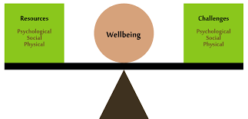
Wellbeing is… Dodge, Daly, Huyton, Sanders, 2012

Slide 5
People with a stronger sense of wellbeing are likely to have higher resilience in the face of adversity, challenges or setbacks

Slide 6
Resilience is the process of adapting well in the face of adversity, trauma, tragedy, threats, or even significant sources of stress — such as family and relationship problems, serious health problems, or workplace and financial stressors. It means “bouncing back” from difficult experiences.

Slide 7
Resilience is the balance between…
Risk factors
Protective factors
Relationship difficulties (abuse, domestic violence, poor communication, infidelity…)
Substance abuse
Unemployment
Financial difficulties
Traumatic experiences
Social isolation
…
Supportive relationships /network (partner, family, friends…)
Strong sense of self efficacy
Self-awareness, self-regulation, self-control, self-discipline…
Skills, strengths, resources, supports or coping strategies
Information and knowledge
…

Slide 9
Activity

Slide 10
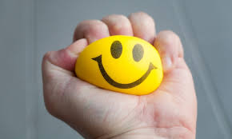
Resilience
Fragility

Slide 11
Personal exercise

Slide 12
Some important concepts
Locus of control – the extent of power you believe you have over your life.
Internal - you believe in your ability to influence events in your life, events that affect you. you would be more likely to improve your situation.
External - you would be inclined to blame external or outside forces for events and their outcomes. You would be more likely to view yourself as a victim of circumstance; unable to have the life you want.
Circle of Concern – things you worry about but cannot influence or do anything about.
Circle of Influence – things you worry about, but which you can influence or do something about

Slide 13
Circle of Concern
Circle of Influence

Slide 14
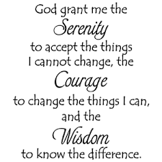
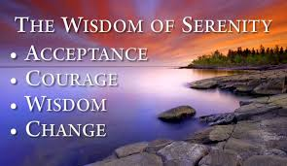

Slide 15
Can resilience be developed (improved / built) ?

Slide 16
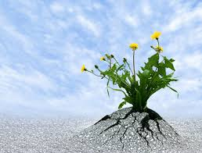
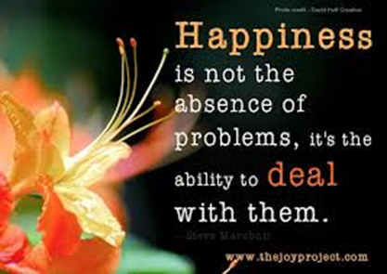
We’re born with innate resilience

Slide 17
PERMA + Seligman, M. 2013
P – Positive emotions (which speak to hedonic feelings of happiness such as amusement, hope, joy, interest, love, compassion, gratitude and pride);
E – Engagement (that refers to feeling connected to activities or organisations e.g. being interested, engaged with or absorbed in something);
R – Relationships (positive relationships refer to feeling cared about and supported, and being integrated with others socially);
M – Meaning (feeling that one is connected to something meaningful and that life is valuable /purposeful);
A – Accomplishment (refers to progress towards goals, feeling capable and experiencing a sense of achievement).
+ OPTIMISM NUTRITION PHYSICAL ACTVITY SLEEP

Slide 18
The following are just a few of the techniques you could focus on in order to foster your own resilience.
Find a Sense of Purpose in Your Life. ...
Build Positive Beliefs in Your Abilities. ...
Develop a Strong Social Network. ...
Embrace Change. ...
Be Optimistic. ...
Nurture Yourself. ...
Develop Your Problem-Solving Skills. ...
Establish Goals.

Slide 19
Parent/caregiver resilience
And Confucius says that everything starts with two people…
Happily together
Unhappily together
Separated / Divorced
Bereaved
(partner has died)
Physically present
Psychologically absent
Adoptive / Reconstituted

Slide 20
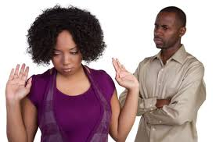
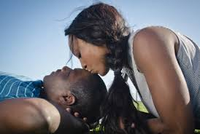
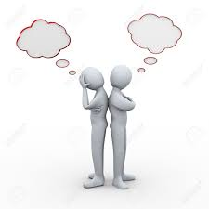
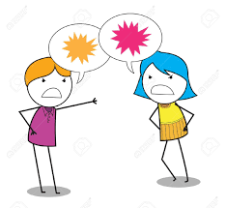
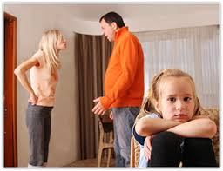
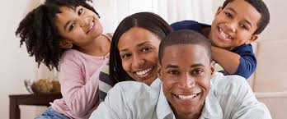
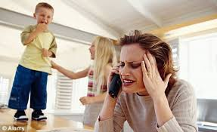
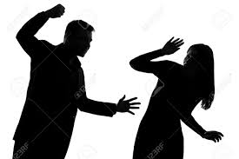

Slide 21
7 habits of resilient parents/caregivers
They don’t play the blame game.
2. They can find humour in tough situations.
3. They ask for help when they need it.
4. They’re not afraid to be vulnerable.
5. They don’t expect their partners to read their minds.
6. They’re committed to solving problems, not ignoring them.
7. They have a genuine desire to move forward.

Slide 22
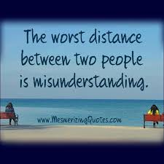
Tune into each other’s Love Languages Gary Chapman
Words of affirmation
Physical touch
Quality time
Acts of service
Gifts

Slide 23
Active constructive communication is key
Positive communication is related to increases in positive mood, which strengthens our relationships and increases well-being on a daily basis (Gable et. al., 2004).

Slide 25
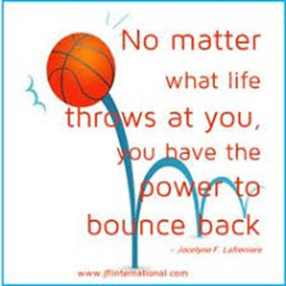
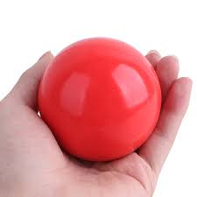
Thank you
Take care and…
BE THE BALL

Slide 26
References
Dodge, R., Daly, A., Huyton, J., & Sanders, L. 2012. The challenge of defining wellbeing. International Journal of Wellbeing, 2(3):222-235. doi:10.5502/ijw.v2i3.4b.
Seligman, M. 2013. Authentic Happiness. Using the New positive psychology to Realize Your Potential for Lasting Fulfillment. Nicholas Brealey publishing. London
Gable, Shelly L., et al. 2004. "What do you do when things go right? The intrapersonal and interpersonal benefits of sharing positive events." Journal of personality and social psychology 87.2 (2004): 228.
Chapman, G. The Five Love Languages -http://www.fivelovelanguages.com/learn.html. Retrieved 5 September 2017.
Kelsey Borresson, Huffpost. 7 habits of resilient couples. http://www.huffingtonpost.com/author/kelsey-borresen

